Slide 1
Time Warrior By: Team BMP
Alex Beerman
John Parks
Matt Morrill
Joe Ortega
Notes:
Introductions, Everyone introduce themselves

Slide 2
Roles
Alex Beerman : Lead Designer/Art Design/World Designer
John Parks : Lead Programmer/Artist/Combat
Matt Morrill : Project Manager/Co-designer
Joe Ortega : Experience System
Notes:
Self-Introduction

Slide 3
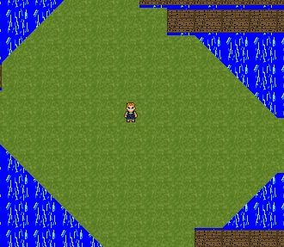
Time Warrior: What it is
2D Action RPG
Homage to Zelda, Diablo, Elder Scrolls
Fantasy Sci-fi
Notes:
Talk here about the plot. Alex talks elevator speech, Matt talks about plot.

Slide 4
Features
Day/Night cycle based on system time.
Scripting Engine.
24 Different skills
Dynamic Enemies
Multiple file save/loads
7 Different areas
Randomly picked dungeons
Everything Levels
Notes:
Day-Night : Alex, Scripting : Alex, Matt, Skills : John, Enemies : ALL, Save/Load : Matt, Areas : Alex, Dungeons : Alex
Speaking: Joe

Slide 5
Group Dynamics
Positives
Good communication
Facebook
Commit notes
Face to face
No conflicts
Code meshed well
Skill levels matched
Negatives
Original fourth member left
Code modified w/o asking
Living locations
John is San Jose
Alex in San Mateo
Matt in Fremont
Notes:
Individual experiences later, only if ask…
John is speaking for most part.

Slide 6
Problems
Largely complex ideas
Sickness
Computer issues
Low networking knowledge
No dedicated artist
Hard delegation of tasks
Deadlines missed
Team Size = {4,3,2,1.5,4,2,3,2,3}
Notes:
Alex calls this slide

Slide 7
Alex Beerman
Notes:
Alex’s slide

Slide 8
John Parks
Notes:
John’s Slide

Slide 9
Matthew Morrill
NBAI
Notes:
Matt’s Slide: RUN. LIKE HELL.

Slide 10
Joe Ortega
Notes:
Joe’s Slide

Slide 11
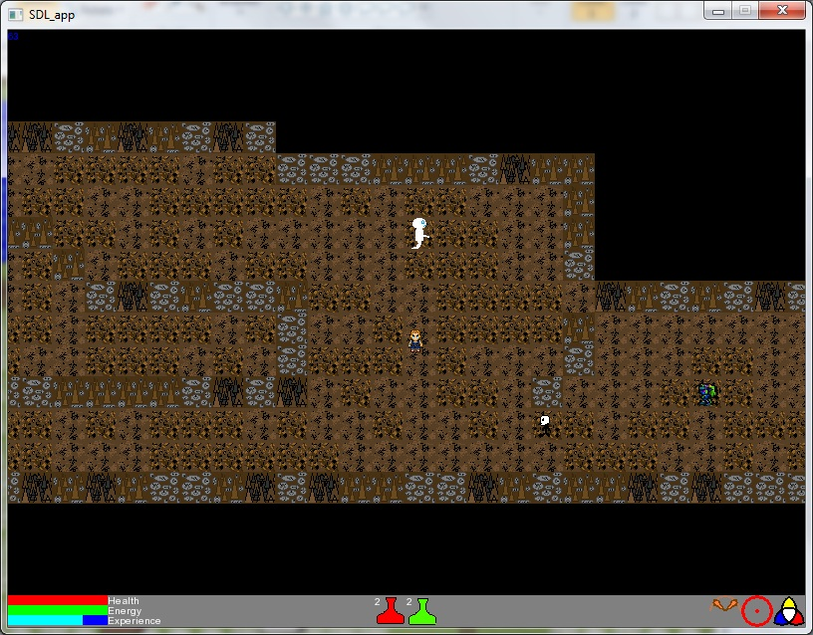
Map Comparisons
Dungeon 1
Notes:
Matt’s talking about this slide and scripting engine. Alex filled it out.

Slide 12




Skills - Weapons
Slash
Blunt
Peirce
Ranged

Slide 13




Skills - Magic
Fire
Ice
Lightning
Divine

Slide 14
Post-Mortem
What we did get in
Large World, dynamic Enemies, Genre-specific entertaining gameplay, All single-player skills.
What didn’t get in
Multiplayer, Magical Combos, Shops, Different quality of Skills, Original ideas of skills, better AI, extra Worlds
Notes:
EVERYONE IS SPEAKING

Slide 15
Future Plans
Get the Three remaining Worlds in
Multiplayer in and functioning
Better character art
BALANCE!!!!!
Notes:
All is speaking

Slide 16
Demo and Questions
EST
U I
Q O
N
M
A
RK
Notes:
Everyone’s Speaking; FINAL SLIDE YAY

